Slide 1
Pipeline and Hazardous Materials Safety Administration (PHMSA) Office of Pipeline Safety (OPS) Accident Investigation Division (AID) Blesson Mathew
Region 4 Regional Response Team
May 29-30, 2024

Slide 2
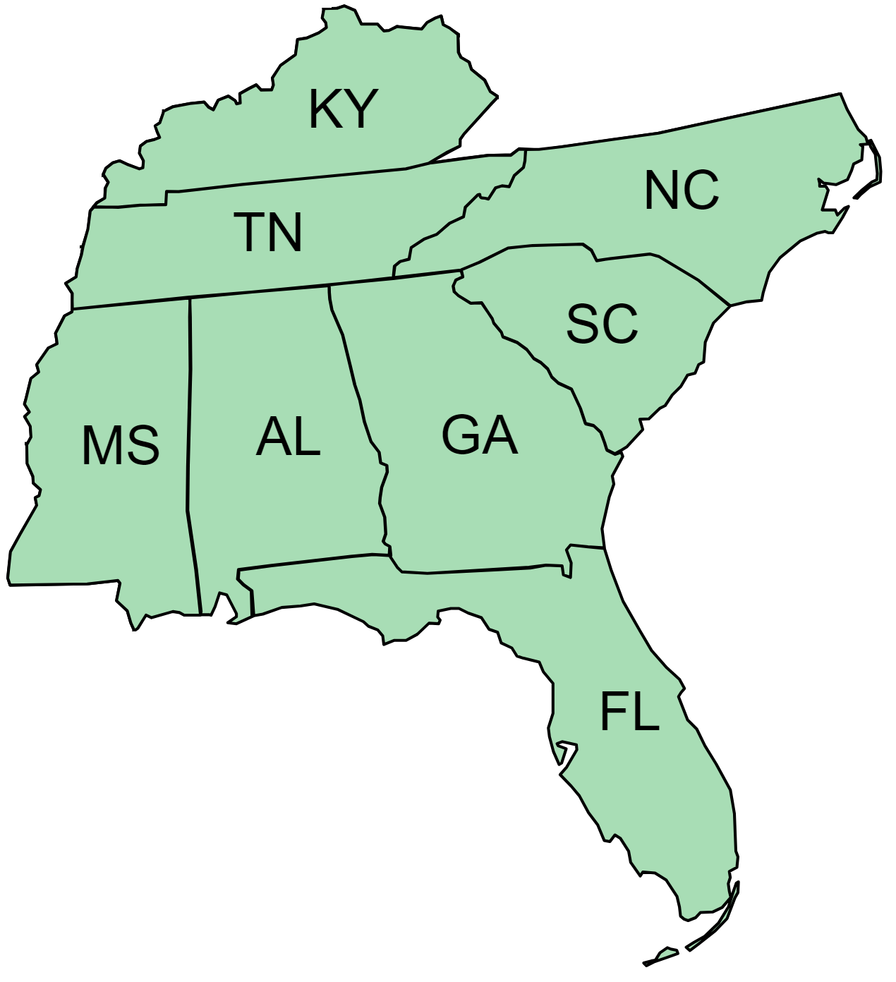
Regional Response Team - Region 4

Slide 3
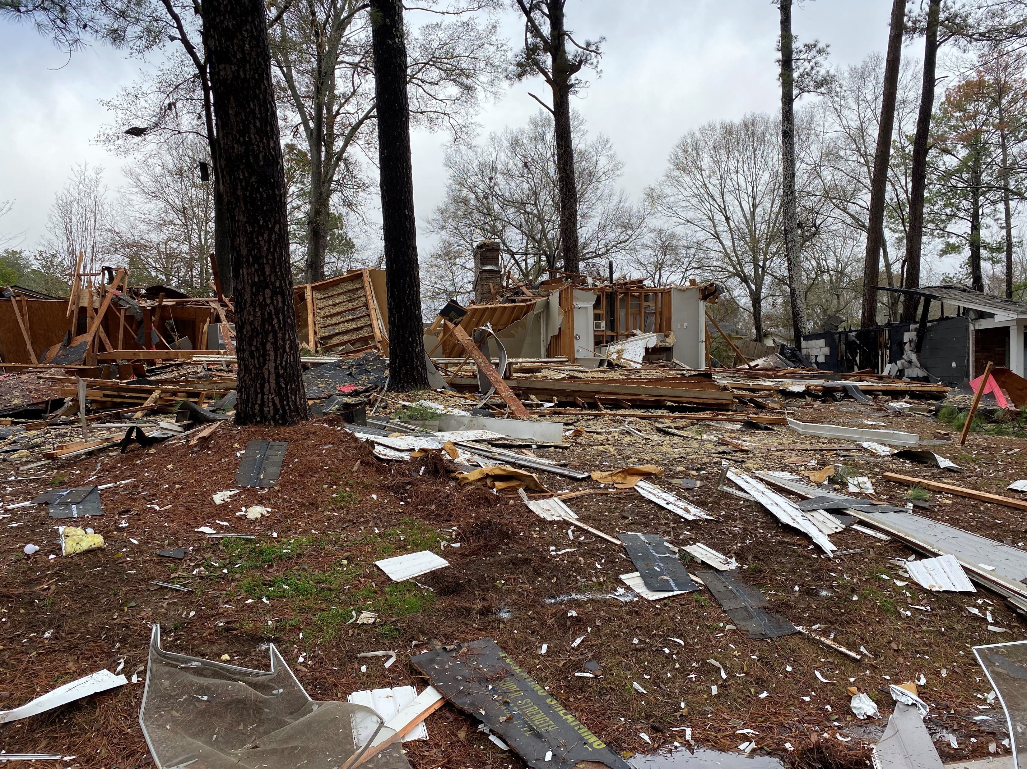
Agenda
Accident Investigation Division
Reporting Incidents / Accidents
Accident Data (2018 – Feb 2024)
Risk Factors
Accident/Incident Data

Slide 4

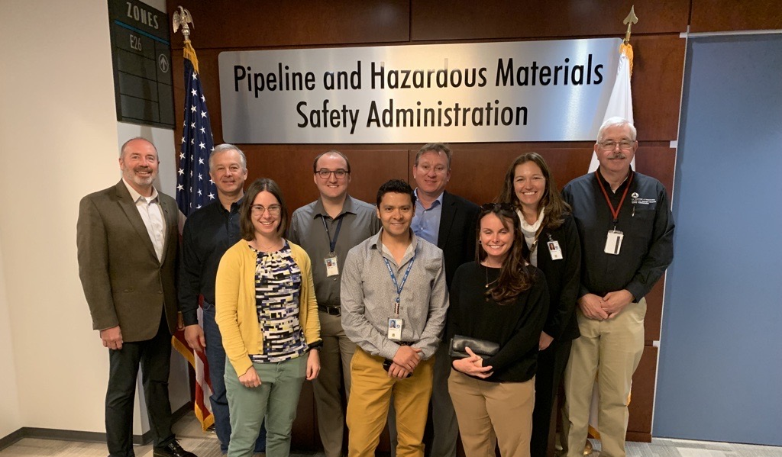
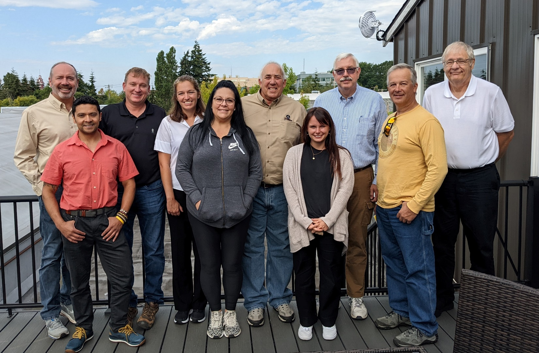
Accident Investigation Division

Slide 5
Accident Investigation Division
Chris Ruhl
Director
LA
Gery Bauman
Sr. Investigator
OK
Lisa Hollingshead
Administrative Assistant
Meg O’Connor
Data Analyst
OH
MN
Brian Pierzina
Sr. Investigator
Ky Nichols
Operations Supervisor
Darren Lemmerman
Sr. Investigator
Curtis Huff
Investigator
Wesley Mathews
Investigator
CO
GA
MI
MN
NE
OK
Alvaro Rodriguez
Investigator
Heather David
Investigator
Timothy Disher
Investigator
Blesson Mathew
Investigator
Jacob Jorgensen
Investigator
Marisa Skillman
Investigator

Slide 6
What does AID do?
National Pipeline Incident Coordinator (NPIC): (888) 719-9033
Review, Evaluate, and Disseminate NRC Notifications
Manage Investigations from Initial Notification through Cause Determination
Conduct Onsite Accident Investigations: Support NTSB and State Investigations
Oversee Operator 30-Day Reports
Publish State and Federal Monthly Accident Report Summary (SMARS/MARS)
Analyze Data to Identify Emerging Trends
Capture and Share Lessons Learned (SAFE Bulletins, Advisory Bulletins, State Seminars, Conferences, etc.)

Slide 7
PHMSA Reporting Requirements
PHMSA has NRC reporting requirements for pipeline systems
Initial (within earliest practical moment following discovery but no later than 1 hour)
Gas
An event involving a release of gas
A death, or personal injury necessitating in-patient hospitalization
Greater than $139,700 estimated property damage
Unintentional estimated gas loss of 3 million cubic feet or more
An event that results in an emergency shutdown of an LNG facility or natural gas storage facility
An event that is characterized as significant by operator
Hazardous Liquids and CO₂
An event involving the release of a liquid and CO₂
A death, or personal injury necessitating in-patient hospitalization
Incident involved a fire or explosion
Greater than $50,000 property damage including the cost of the cleanup, value of product
Resulted in pollution of any stream, river, lake, reservoir or similar body of water
An event that is characterized as significant by operator
48-hour
Must provide an update to confirm/revise initial information reported.

Slide 8








Pre-30-Day Report Review
Reported by Operator
Incident
Yes
NRC and Telephonic
NPIC Reviews
Close
*
No
**
Operator Reviews
Regulated (OPS/State)
**The notification process is further explained below
No
Manual Input on WMS
30-Day Report Submission
Yes
Recorded by Operator
No
Yes
30 -Day Report Expected
Manual Input on WMS
*This process is speculative and independent from AID. However, AID receives 30-Day Reports without NRC associated with the incident.
AID Pending Review

Slide 9

Notification of Regulated Incidents
Regulated Event
OPS
Yes
NPIC Notifies Stakeholders AID Contacts Operator
No
Determine Investigation Level
NPIC Provides Updates to OPS, Division, Other Agencies
NPIC Notifies Stakeholders State Contacts Operator
30 -Day Report Expected
LEVEL 1 Baseline
LEVEL 2 Off-scene Investigation
LEVEL 3 On-scene Investigation
AID Pending Review
48-hour Update

Slide 10
NPIC Duty and High-Consequence* Incidents
Important to get timely state responses
Courtesy phone calls may also be made to state duty officer or program manager
Generally, NPIC will contact operator after 15 minutes
Disseminate known information
States, Regions, Preparedness, Emergency Support, and Security Division (PESS), PHMSA Executives, NTSB, and Others when necessary (EPA, BSEE, USCG, Tribes, etc.)
State plays an important role in future updates (scheduling and content)
*explosions, deaths, injuries, environmental impact

Slide 11
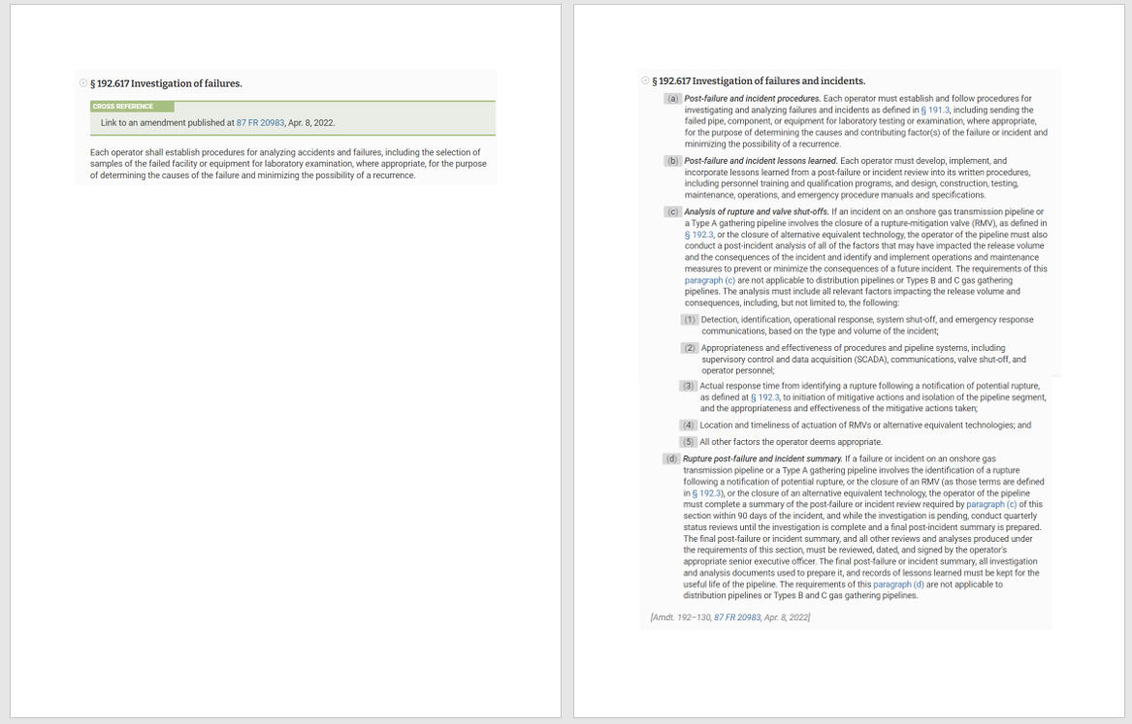
Investigation of Failures 192.617, 195.402 (c)
Significant changes effective on 10/5/2022
(a) Post-failure and incident procedures:
Establish procedures for investigating failures, sending failed equipment for testing to determine causes, and preventing recurrence.
(b) Post-failure and incident lessons learned:
Incorporate lessons learned from incidents into written procedures, training programs, and manuals.
(c) Analysis of rupture and valve shut-offs:
Conduct a post-incident analysis for closures of rupture-mitigation valves, considering factors impacting release volume and consequences.
(d) Rupture post-failure and incident summary:
Complete a summary of post-incident analysis within 90 days for incidents involving rupture identification or valve closures.
Conduct quarterly reviews until the investigation is complete and keep records for the pipeline's useful life.
Before
After
Note: Not applicable to distribution pipelines or Types B and C gas gathering pipelines.
Notes:
Changes to 192.617 are mirrored in 195.402(c)
Regulations are updated on Federal Registry

Slide 12
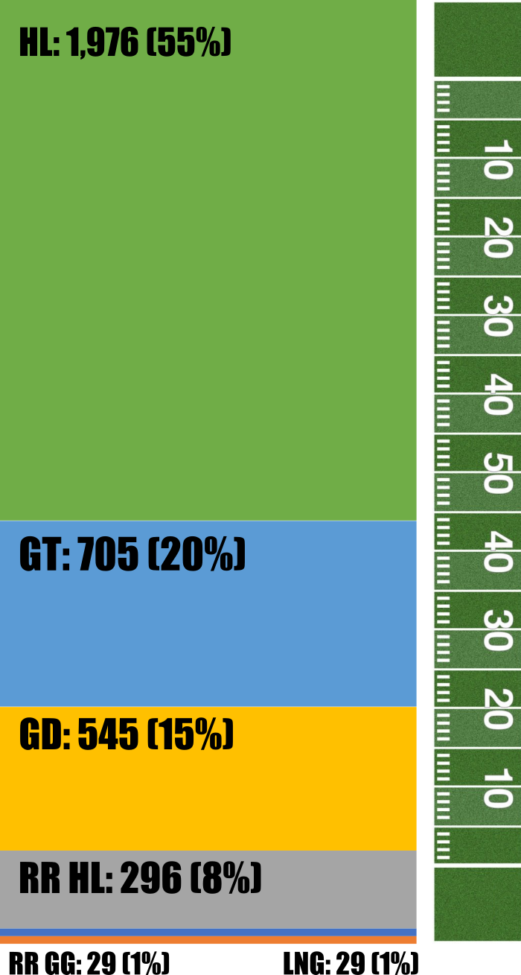
Number of Reportable Accidents/Incidents (2018-2023)
System | OPS | State | Total
LNG | 15 | 14 | 29
RR GG | 29 |  | 29
GRR HL | 296 |  | 296
GD | 3 | 542 | 545
GG/GT/UNGS | 468 | 237 | 705
HL | 1,291 | 685 | 1,976
GT
HL
Yards: 66, 24, 18, 10, 1, 1

Slide 13
Number of Reportable Accidents by Cause (HL, GT, GD)
2018 - 2023
Qty
HL: 1,976
GT: 705
GD: 545
PHMSA Accident Data

Slide 14
Number of Reportable Accidents by Cause (Other Systems)
2018 - 2023
Qty
RR HL (Reporting Regulated) (Starting in 2021): 296
LNG (Starting in 2011): 29
RR GG: Type R (Starting in 2022): 29

Slide 15
*Risk Factors (2018-2023)
Cathodic Protection
Communication/Planning/Hazard Assessment
Construction Practices
Control Room Operations
Data integration
Design
Distracted Employee
Emergency Response - Environmental Protection
Emergency Response - People protection
Excavation Practices
Human Error Other
Integrity Assessment Methods
Integrity Threat Identification
Leak detection
Manufacturing defect
Maps/Records
Preventative Maintenance
Procedures
Incorrect
Not Developed
Not Followed
Repair/Maintenance Work
Risk Factor
Not Yet Determined
Undefined
Unknown
Software logic
Training
*Developed and implemented by AID starting with 2018 data – It can only be accessed through PHMSA WMS
Notes:
AID has developed 26 risk factors. These were designed to represent the many potential opportunities operators could have improved upon to prevent the accident or could have significantly decreased the consequences.
These are not specifically code based but rather topical. They do represent many code sections and IA modules.
We can also add multiple risk factors for a single event, each hole in the swish cheese can be documented
Inspectors can use these risk factors for both industry and operator profiling to identify areas to strengthen safety barriers.
(((Walk through each)))
Cathodic Protection - The failure resulted from external corrosion.
Communication/Planning/Hazard Assessment - When a failure occurs during maintenance work and there was a failure to discuss or identify a hazard before the work was performed.
Construction Practices - Craftsmanship error on a new pipeline and commissioning issues.
Control Room Operations - The CR Operator failed to correctly operate valves or pumps or take other actions to reduce consequences
Data integration - The operator had data and failed to combine it with other information available or share with other personal.
Design - A design error to a newly constructed pipeline. If the failure occurred on a line that has been operating for more than a year, integrity threat identification is suggested.
Distracted Employee - An employee forgot to open/close a valve or perform an action as required due to distraction, fatigue, or other PSM issue
Emergency Response/Environmental - During the release containment phase, actions lead to additional contamination and/or release volumes.
Emergency Response/People - During the emergency phase, actions by either the operator or emergency responders lead to additional deaf or injuries.
Excavation Practices - This is specific to an accident caused by excavation by 1st, 2nd, or 3rd parties and for events where an excavation notice was not provided. This includes those events where a regulated operator was not at fault.
Human Error Other - This is used when other risk factors do not address a human action that was directly related to the failure.
Integrity Assessment Methods - When ILI tools, hydrotesting or direct/indirect assessments are used, and a failure still occurs from an unidentified threat by the use of these techniques. Such as pressure reversals failures after hydrotesting, SCC failures, corrosion failures etc.
Integrity Threat Identification - When a threat exists, and the operator is not looking for it or is unaware of the threat and a failure occurs. For example, SCC on a pipeline that is not considered a threat, internal corrosion on low flow/dead legs/relief lines, vibration fatigue failures, small diameter piping failures, lack of support, atmospheric corrosion, freezing water in control lines, regulators and reliefs, buried and aboveground flanges.

Slide 16
Risk Factors (2018 – Dec 2023) – All Products
Top 7

Slide 17
All Failure Mechanisms for HL
All Failure Mechanisms for GT
Seals
O-rings
ESD
Notes:
Let's compare the top 5 risk factors for each HL and NG. Both external and internal are in the 4 for both products. These are both basic failure mechanisms. It is clear that looking at rectifier records and annual survey records alone is not what is needed to reduce external corrosion failures. 195 has a requirement for CIS procedures yet the majority of the failures have never had one done in the last 5 years. Internal corrosion is a matter of identifying where the threat may be occurring and mitigate it.
For HL there are a lot of pump seal, tank mixer and valve stem failures. For pump seals, if the release can adequately enter the seal pot and make it to the sump it does not get reported. So, in reality the seal pots also fail to collect the release or the line to the sump is clogged. Many tank mixers do not have seal pots and valve stem leaks often are a lack of maintenance and stem pitting.
What does HL operators do differently that GT? 3rd party damage is number 3. Possibly the lines are more urbanely located? GT has a huge problem with ESD’s failing to operate properly. Often they trip without need and when they are needed, they won’t close properly and continue to blow gas from the mainline until an operator can manually close valves. In some cases the operator gets notified by local responders that their station is blowing gas.
For HL the top 7 sub-causes happen to be all be related to facility piping.
How does NG compare? (((Next slide)))

Slide 18
RRT4 – Accident Data (2018 – Feb 2024)

Slide 19
RRT4 – Accident Data (2018 – Feb 2024)

Slide 20
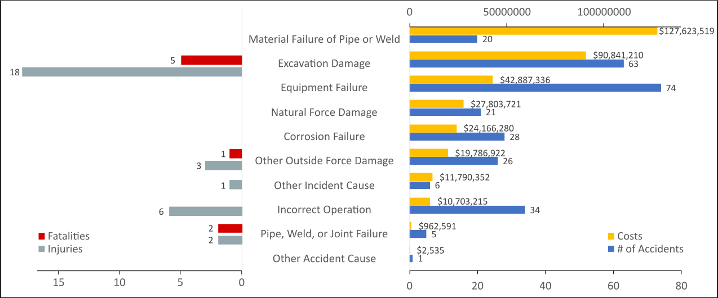
Accidents by Cause Type (2018 – Feb 2024)
*In August 2020, Colonial Pipeline had a release of 47,619 barrels of gasoline in Huntersville, NC. Total costs reached more than $100 M in damages.

Slide 21
GD Incidents by Cause Type (2018- Feb 2024)
2 injuries, 2 fatalities
1 injury
1 injury

Slide 22
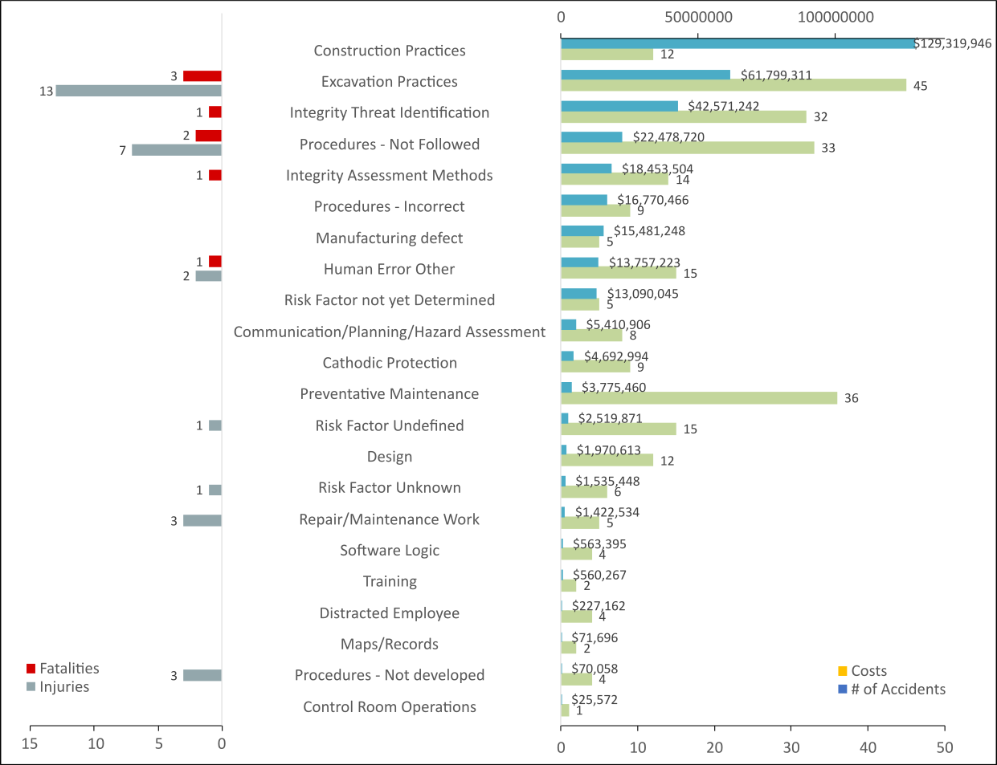
Region 4 Accidents by Risk Factor
2018 - Feb 2024

Slide 23
GD Incidents by Risk Factor (2018-Feb. 2024)
1 fatality
2 injuries, 1 fatality
1 injury
1 injury

Slide 24
GT Incidents by Cause and Risk Factor (2018- Feb. 2024)

Slide 25
HL Incidents by Cause (2018-2023)

Slide 26
HL Incidents by Risk Factor (2018-2023)

Slide 27
Questions
Pipeline and Hazardous Materials Safety Administration (PHMSA) - Office of Pipeline Safety (OPS)
Accident Investigation Division (AID)
Blesson Mathew
Pipeline Accident Investigator
Blesson.mathew@dot.gov
404-565-3488

Slide 28
Extra Slides

Slide 29
Hazardous Liquid Accidents (2018 – 2023)
Equipment Failure | 966
Non-threaded Connection Failure | 309
Pump or Pump-related Equipment | 188
Threaded Connection/Coupling Failure | 146
Malfunction of Control/Relief Equipment | 119
Other Equipment Failure | 117
Defective or Loose Tubing or Fitting | 48
Failure of Equipment Body (except Pump), Tank Plate, or other Material | 39
Corrosion Failure | 433
Internal Corrosion | 283
External Corrosion | 150
Qty
HL: 2,100

Slide 30
Gas Transmission Incidents (2018 – 2023)
Equipment Failure | 288
Malfunction of Control/Relief Equipment | 186
Other Equipment Failure | 28
Threaded Connection/Coupling Failure | 24
Non-threaded Connection Failure | 21
Compressor or Compressor-related Equipment | 13
Defective or Loose Tubing or Fitting | 11
Failure of Equipment Body (except Compressor), Vessel Plate, or other Material | 5
Corrosion Failure | 137
Internal Corrosion | 72
External Corrosion | 65
Qty
GT: 762

Slide 31
Gas Distribution Incidents (2018 – 2023)
Excavation Damage | 241
Excavation Damage by Third Party | 208
Excavation Damage by Operator’s Contractor (Second Party) | 19
Previous Damage due to Excavation Activity | 9
Excavation Damage by Operator (First Party) | 5
Other Outside Force Damage | 173
Damage by Car, Truck, or Other Motorized Vehicle/Equipment NOT Engaged in Excavation | 77
Other Outside Force Damage | 35
Nearby Industrial, Man-made, or Other Fire/Explosion as Primary Cause of Incident | 30
Electrical Arcing from Other Equipment or Facility | 17
Intentional Damage | 12
Erosion of Support Due to Other Utilities | 1
Previous Mechanical Damage NOT Related to Excavation | 1
Qty
GD: 660

Slide 32
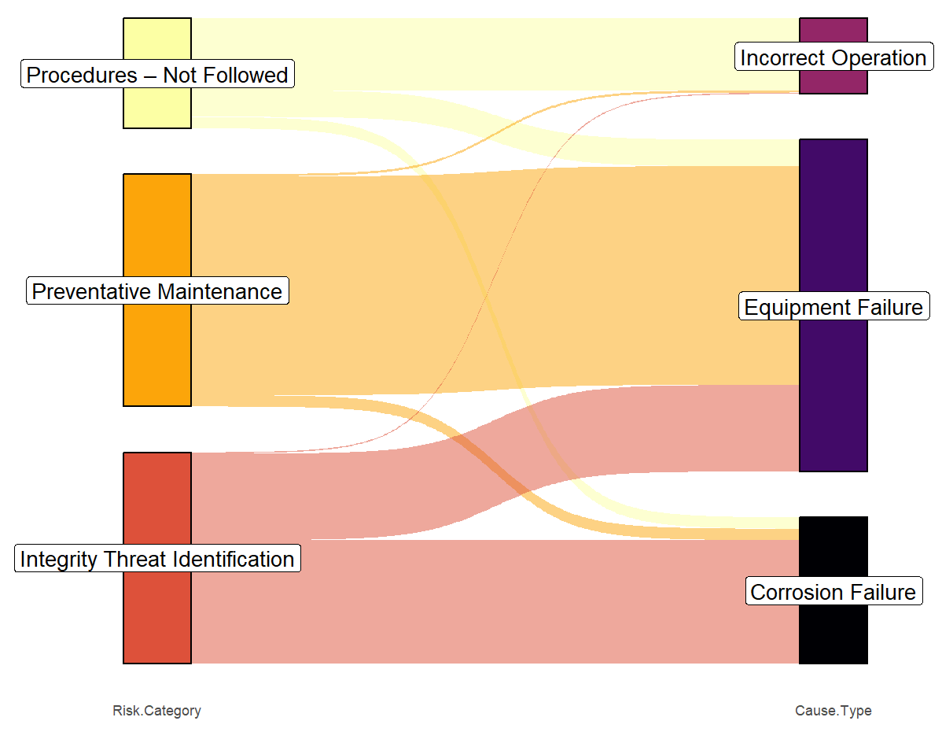
Sankey Diagram – Hazardous Liquid
Top 3 Risk Categories and Top 3 Accident Causes (2018-2023)

Slide 33
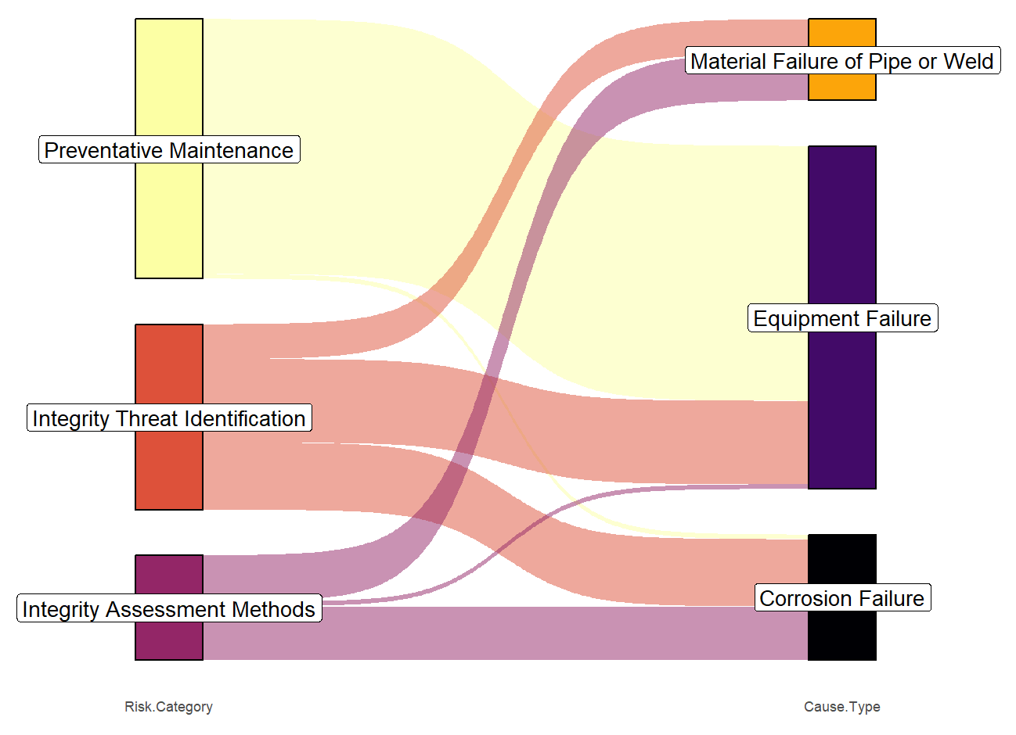
Sankey Diagram – Gas Transmission
Top 3 Risk Categories and Top 3 Incident Causes (2018-2023)

Slide 34
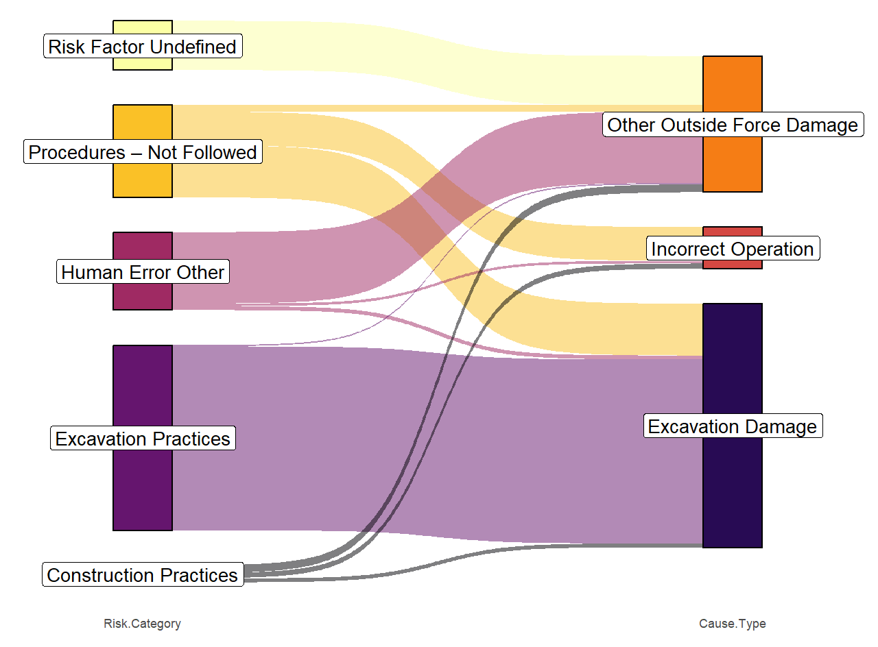
Sankey Diagram – Gas Distribution
Top 5 Risk Categories and Top 3 Incident Causes (2018-2023)

